Slide 1

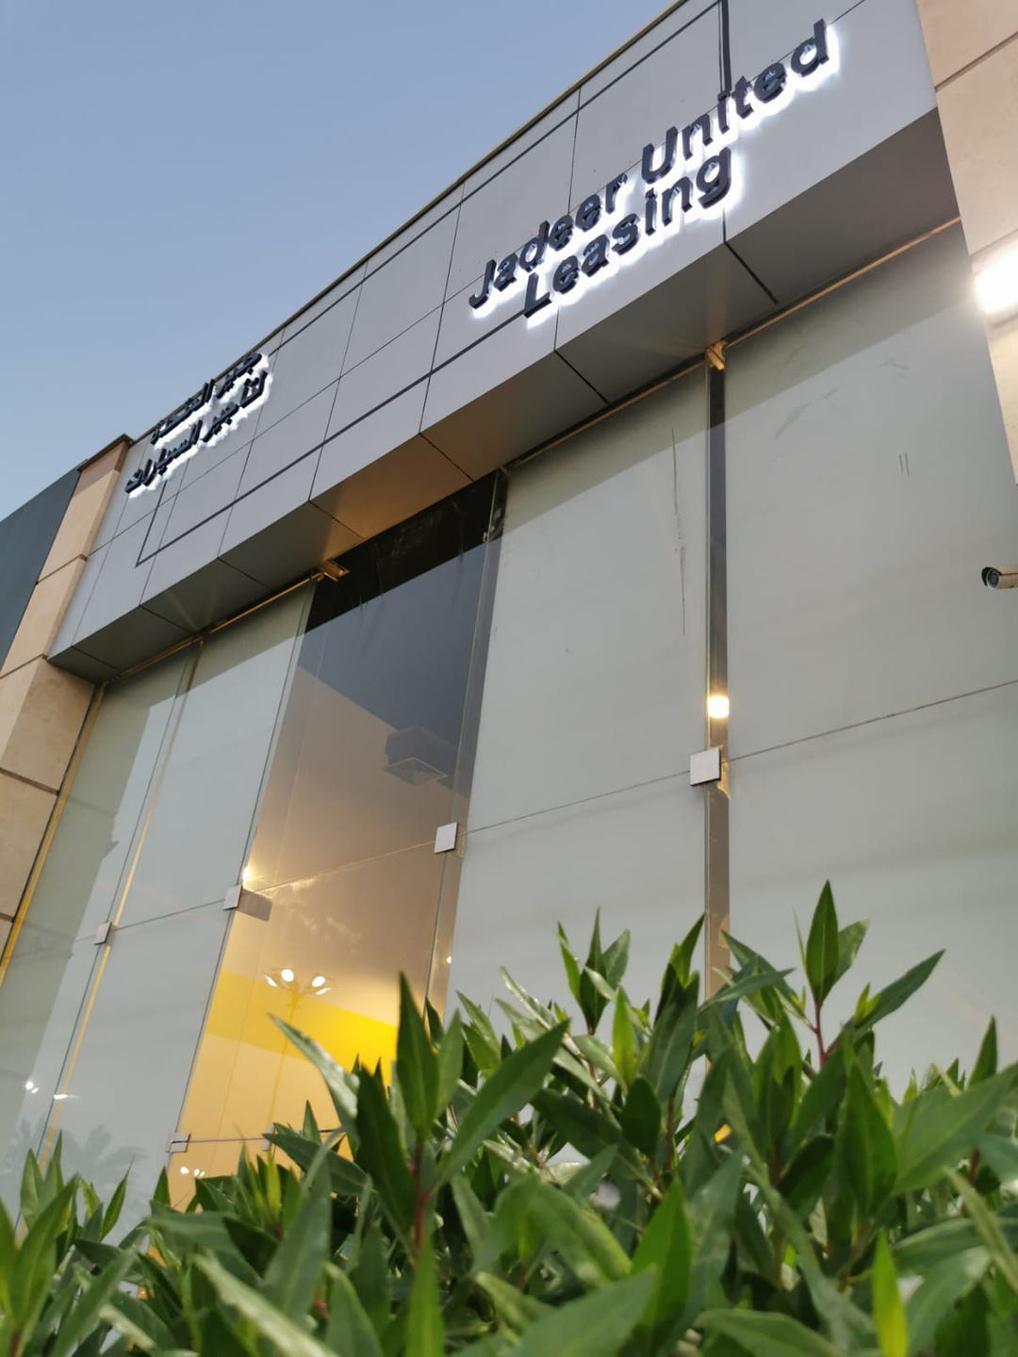

JADEER
UNITED
TRANSPORTATION SOLUTIONS THAT DRIVE BUSINESS SUCCESS AND SUSTAINABILITY
www.Jadeerunited.com

Slide 2


ABOUT JADEER
Founded in 2009, Jadeer United stands as a premier transportation solution provider across Bahrain, Saudi Arabia, and Oman. we specialize in delivering high-quality, sustainable, and innovative transportation services tailored to the needs of both businesses and individual clients. Our management team brings more than 25 years of industry experience, ensuring excellence and reliability in all we do.
VISION
"To lead in providing innovative and efficient transportation solutions in Bahrain, Saudi Arabia, and Oman, driving business success and sustainability for our business partners.
MISSION
"Empowering businesses with superior transportation solutions, prioritizing quality, reliability, and sustainability."
ABOUT US | PAGE 02

Slide 3

VALUES
Continuous Improvement: We are committed to constantly seeking smarter, more efficient ways to enhance our services.
Respect for People: We value and empower our team to contribute significantly to our success.
Customer Focus: We prioritize client needs to deliver beyond expectations.
Innovation: We continuously explore new ideas to lead the transportation industry.
Teamwork: We collaborate effectively to achieve our common goals.
Quality: We maintain the highest standards in every service we provide.
Flexibility: We adapt our offerings to meet evolving client demands.
Long-Term Perspective: We plan strategically for sustainable growth.
VALUES | PAGE 03

Slide 4
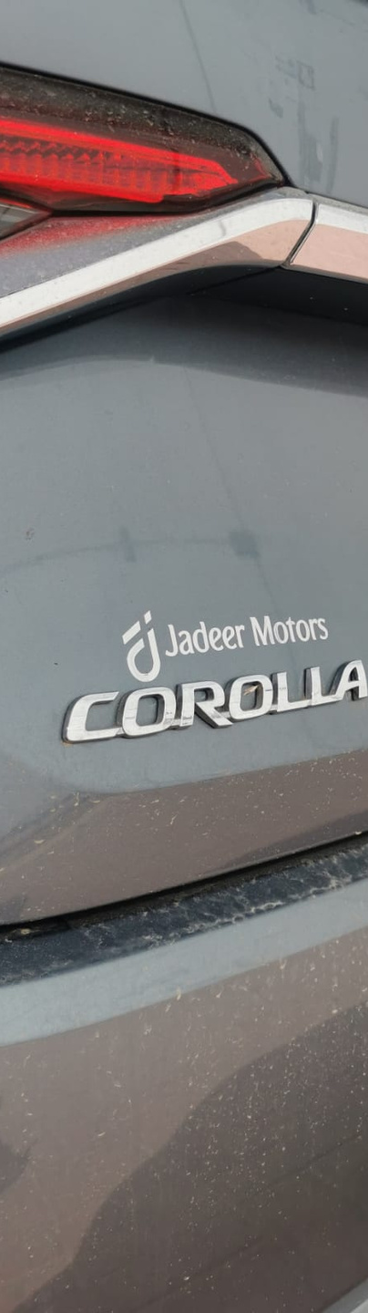
SERVICES OFFERED.
Operational Leasing: Comprehensive operational leasing options that are flexible and cost-effective, tailored specifically for corporate needs.
Car Rentals: A wide range of rental services offering both short-term and long-term solutions, featuring a diverse fleet of vehicles to suit all needs.
Sales of New and Used Cars: A curated selection of new and used vehicles, Allows businesses and individuals to purchase high-quality, and reliable vehicles.
Limousine Services: Offering luxurious limousine services for special occasions, corporate events, or VIP transportation needs.
Driver Services: Providing professional drivers for those requiring dedicated transportation services.
SERVICES OFFERED. | PAGE 04

Slide 5
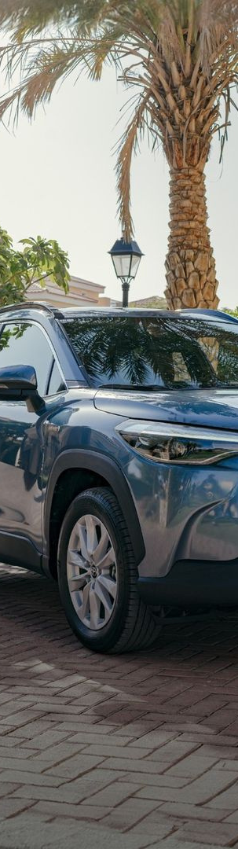
SERVICES OFFERED.
Maintenance and Spare Parts: Providing maintenance according to the manufacturer's recommended schedule and spare parts throughout the contract duration.
Quick Service Facilities: Over 700 quick service facilities available through our partnerships with B2B partners.
Insurance and Support: We offer fully comprehensive insurance coverage in Saudi Arabia, Bahrain, and Oman.
replacement vehicles: we provide replacement vehicles in the event of an accident or breakdown.
Door-to-Door Services: Offering convenient door-to-door service for enhanced customer comfort and efficiency.
24/7 Mobile Service: Our mobile service crew is available around the clock to assist our clients whenever required.
Vehicle Tracking and Access Control: Equipping each vehicle with a tracking system and blue key to ensure security and manage usage effectively.
Vehicle Safety Enhancements: Installing roll bars and roll cages that meet USA standards for additional vehicle safety.
SERVICES OFFERED. | PAGE 05

Slide 6










Our Clients
2
Our Clients. | PAGE 06

Slide 7
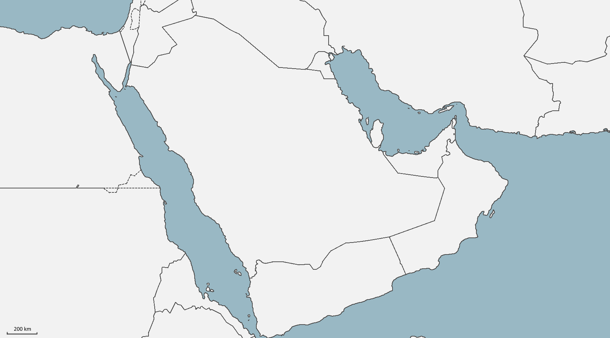
Our Locations
Tabuk
Khafji
Neom
Turaif
Jubail
Ras al Khair
Khobar
Bahrain
Yanbu
Rabigh
Riyadh
Jeddah
Jizan
Our Locations. | PAGE 07

Slide 8
CONTACT INFORMATION
Jadeer United Motors
Headquarters:
Bahrain: [ Amwaj ] [+973 6666 6064]
Branch Offices:
Saudi Arabia: [ Khobar ] [+966 56887 7769]
Oman: [ Muscat ] [+968 7745 9000]
Email:
Customer Support: Maisara@jadeergulf.com
Sales Team: sales@jadeergulf.com
General Inquiries: info@jadeergulf.com
Website: www.jadeerunited.com
Business Hours:
Sunday to Thursday: 8:30 AM - 5:30 PM
Friday: Closed
Saturday: 9:00 AM - 1:00 PM
Position
Position
Position
Position
Success is never owned, is leased and the rent is due Every day.
CONTACT INFORMATION | PAGE 08

Slide 9
Strategic Focus Our strategic plan
focuses on enhancing digital capabilities, expanding market penetration in Bahrain, Saudi Arabia, and Oman, and introducing sustainable transportation solutions like hybrid vehicle leasing.
We are committed to continuous innovation to keep pace with market demands and to exceed the expectations of our clients.
Commitment to Sustainability Aligned with global standards and local initiatives like Bahrain, Saudi Arabia, and Oman Vision 2030.
www.Jadeerunited.com
+966 56887 7769 +973 66666064 +968 7745 9000
info@jadeergulf.com

